Slide 1
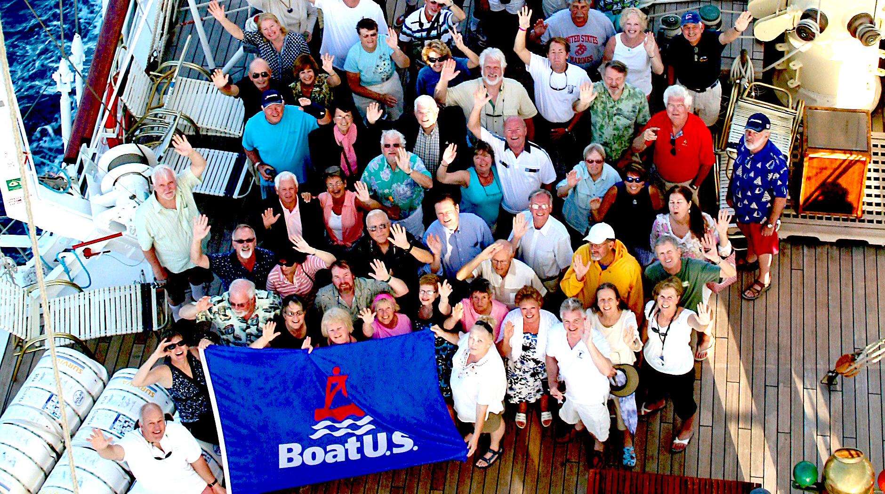

COOPERATING
GROUP
PROGRAM

Slide 2
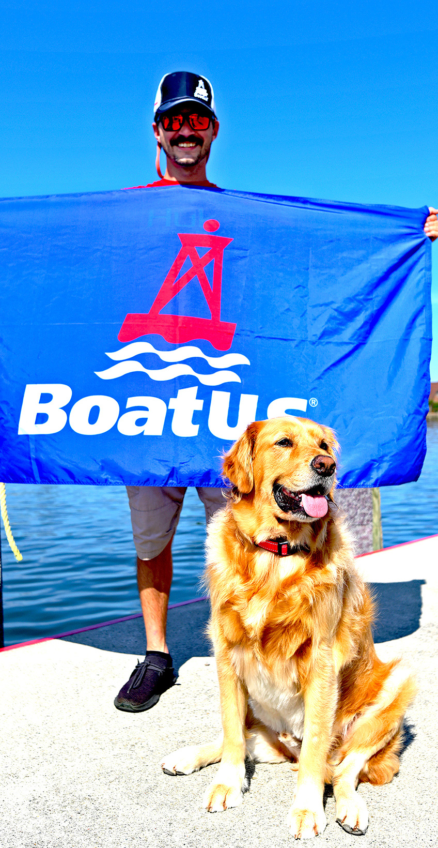
ABOUT THE
ASSOCIATION
Join the nation’s largest association of recreational boaters
and you’ll be in good company with over 700,000 Members who share a passion for all things boating. If you love nothing more than getting out on your boat and want to make the most of your time on the water, a BoatU.S. Membership is right for you.

Slide 3
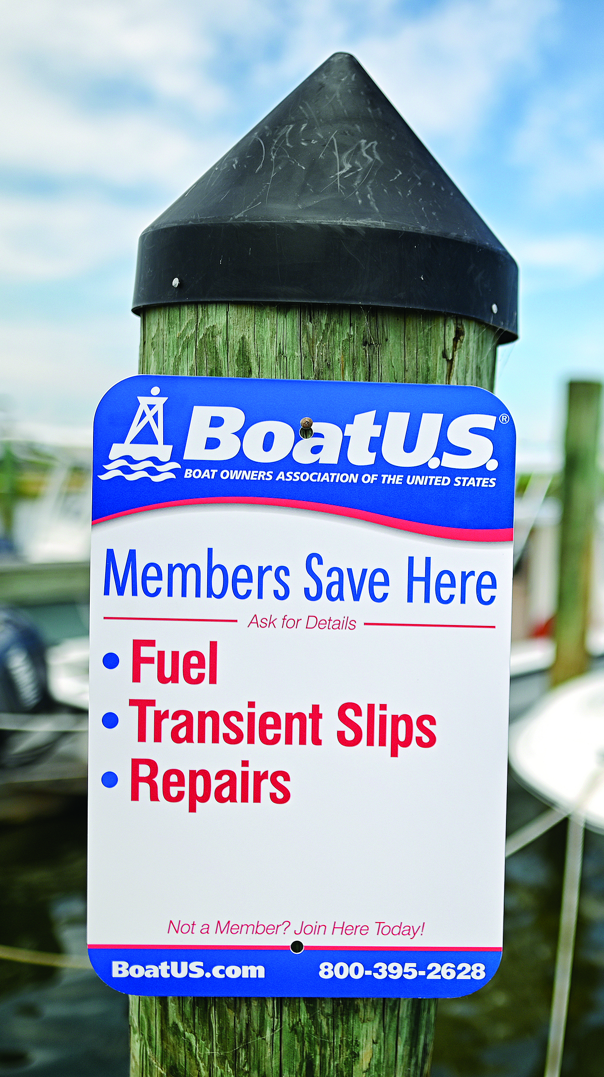
MEMBERSHIP
BENEFITS
Discounts on Fuel, Slips, Repairs and More
On-the-Water and On-the
Road Towing
Rewards Program with West Marine
Subscription
to BoatU.S. Magazine
Boat Graphics
and
Lettering
Fighting
For boaters
rights
Partner discounts and travel savings
Free MMSI
Number

Slide 4


COOPERATING
GROUP PROGRAM
When any group member joins or renews their BoatU.S. Membership for $25, they get 10% off
Freshwater or Saltwater Towing services.
Coop Group participants should help educate their members about the benefits of BoatU.S. Membership.
To join, visit BoatUS.com/Join and enter your club’s unique source code or BoatU.S. code GAXXXXXX
in the “BoatUS Cooperating Group Number” field
Existing Members can add their club’s unique source code or BoatU.S. code GAXXXXXX to their Membership by emailing Membership@BoatUS.com or entering it in the “BoatUS Coop Group #” field when renewing their Membership on BoatUS.com/Renew
INTERESTED IN JOINING OR HAVE QUESTIONS? Email Partner@BoatUS.com or call 800-395-2628

Slide 5
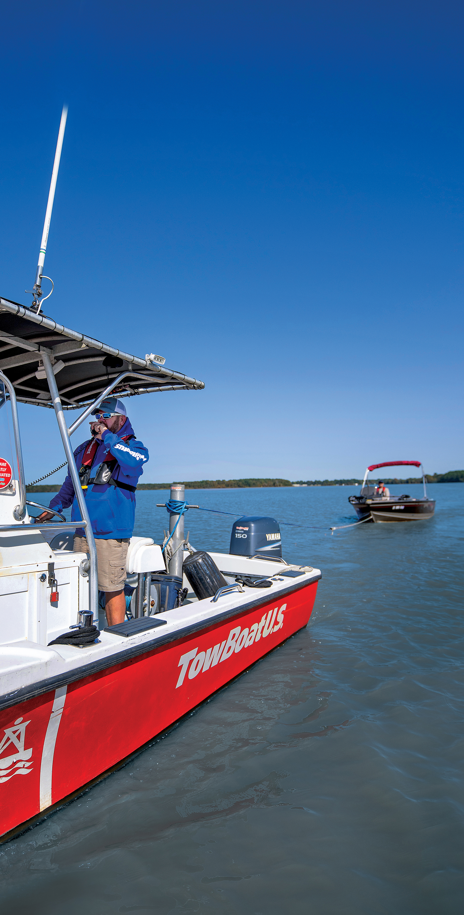

Service provided by
DISCOUNTED
TOWING PRICING
$25
Basic
Membership
$99
(retail $109)
Freshwater Towing
Membership
BoatUS pays 100% for towing and 50% for dock- to-dock tows for repairs
$158
(retail $175)
Saltwater Towing
Membership
$194
(retail $215)
Gold Towing
Membership
BoatUS pays 100% for towing and 50% for dock- to-dock tows for repairs
BoatUS pays 100% for towing and 100% for dock- to-dock tows for repairs

Slide 6
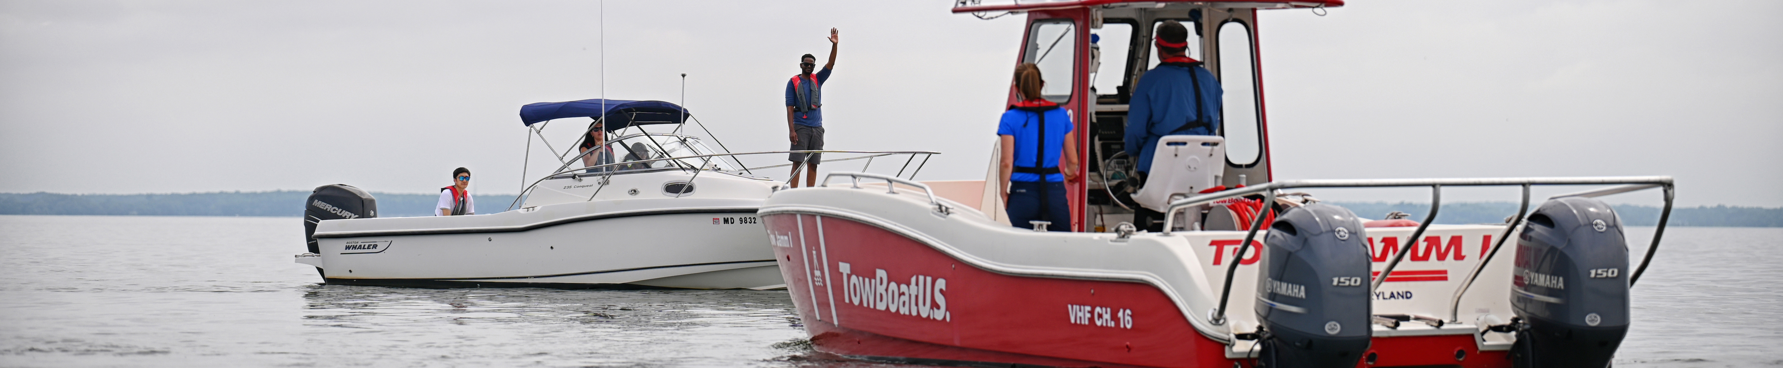
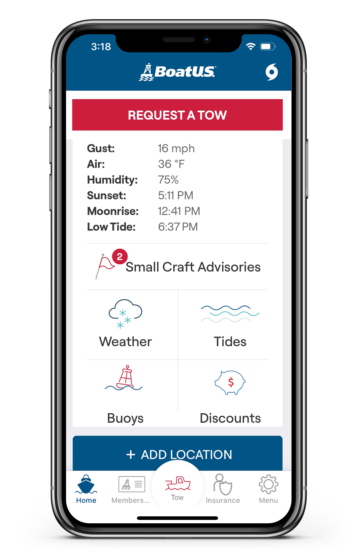
ON-THE-WATER
TOWING MEMBERSHIP
HIGHLIGHTS
  HOW TO GET HELP ON
  THE WATER:
  • Download the BoatU.S. App
  • Call 800-391-4869
  • Hail “TowBoatU.S.” on VHF 16
• 24-hour dispatch, 365 days a year
• 600+ TowBoatU.S. towboats in 300+ ports
• Members receive priority service
• Towing, battery jumpstarts, soft ungroundings and fuel delivery
• Provides for any recreational boat you own, borrow, or charter

Slide 7
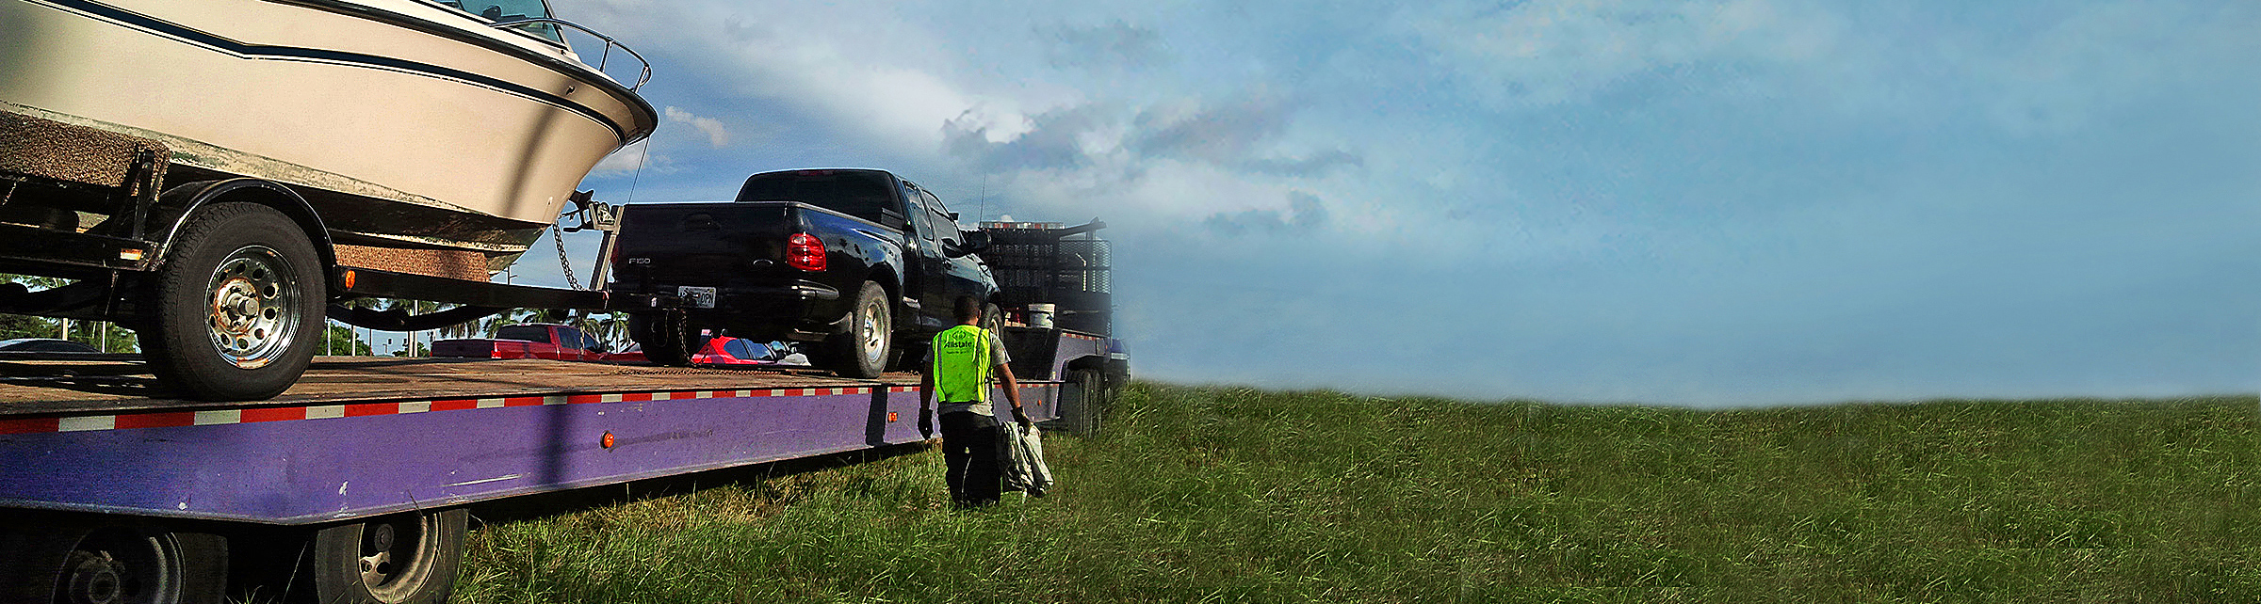
ON-THE-ROAD
TOWING MEMBERSHIP
HIGHLIGHTS
Get roadside assistance
for both your trailer and the tow vehicle while trailering your boat
• Just $15/year with BoatU.S. Membership
• 24/7 dispatch, 365 days
  • 100 miles of roadside towing assistance
  • Flat tires, jump starts and lockout service included

Slide 8


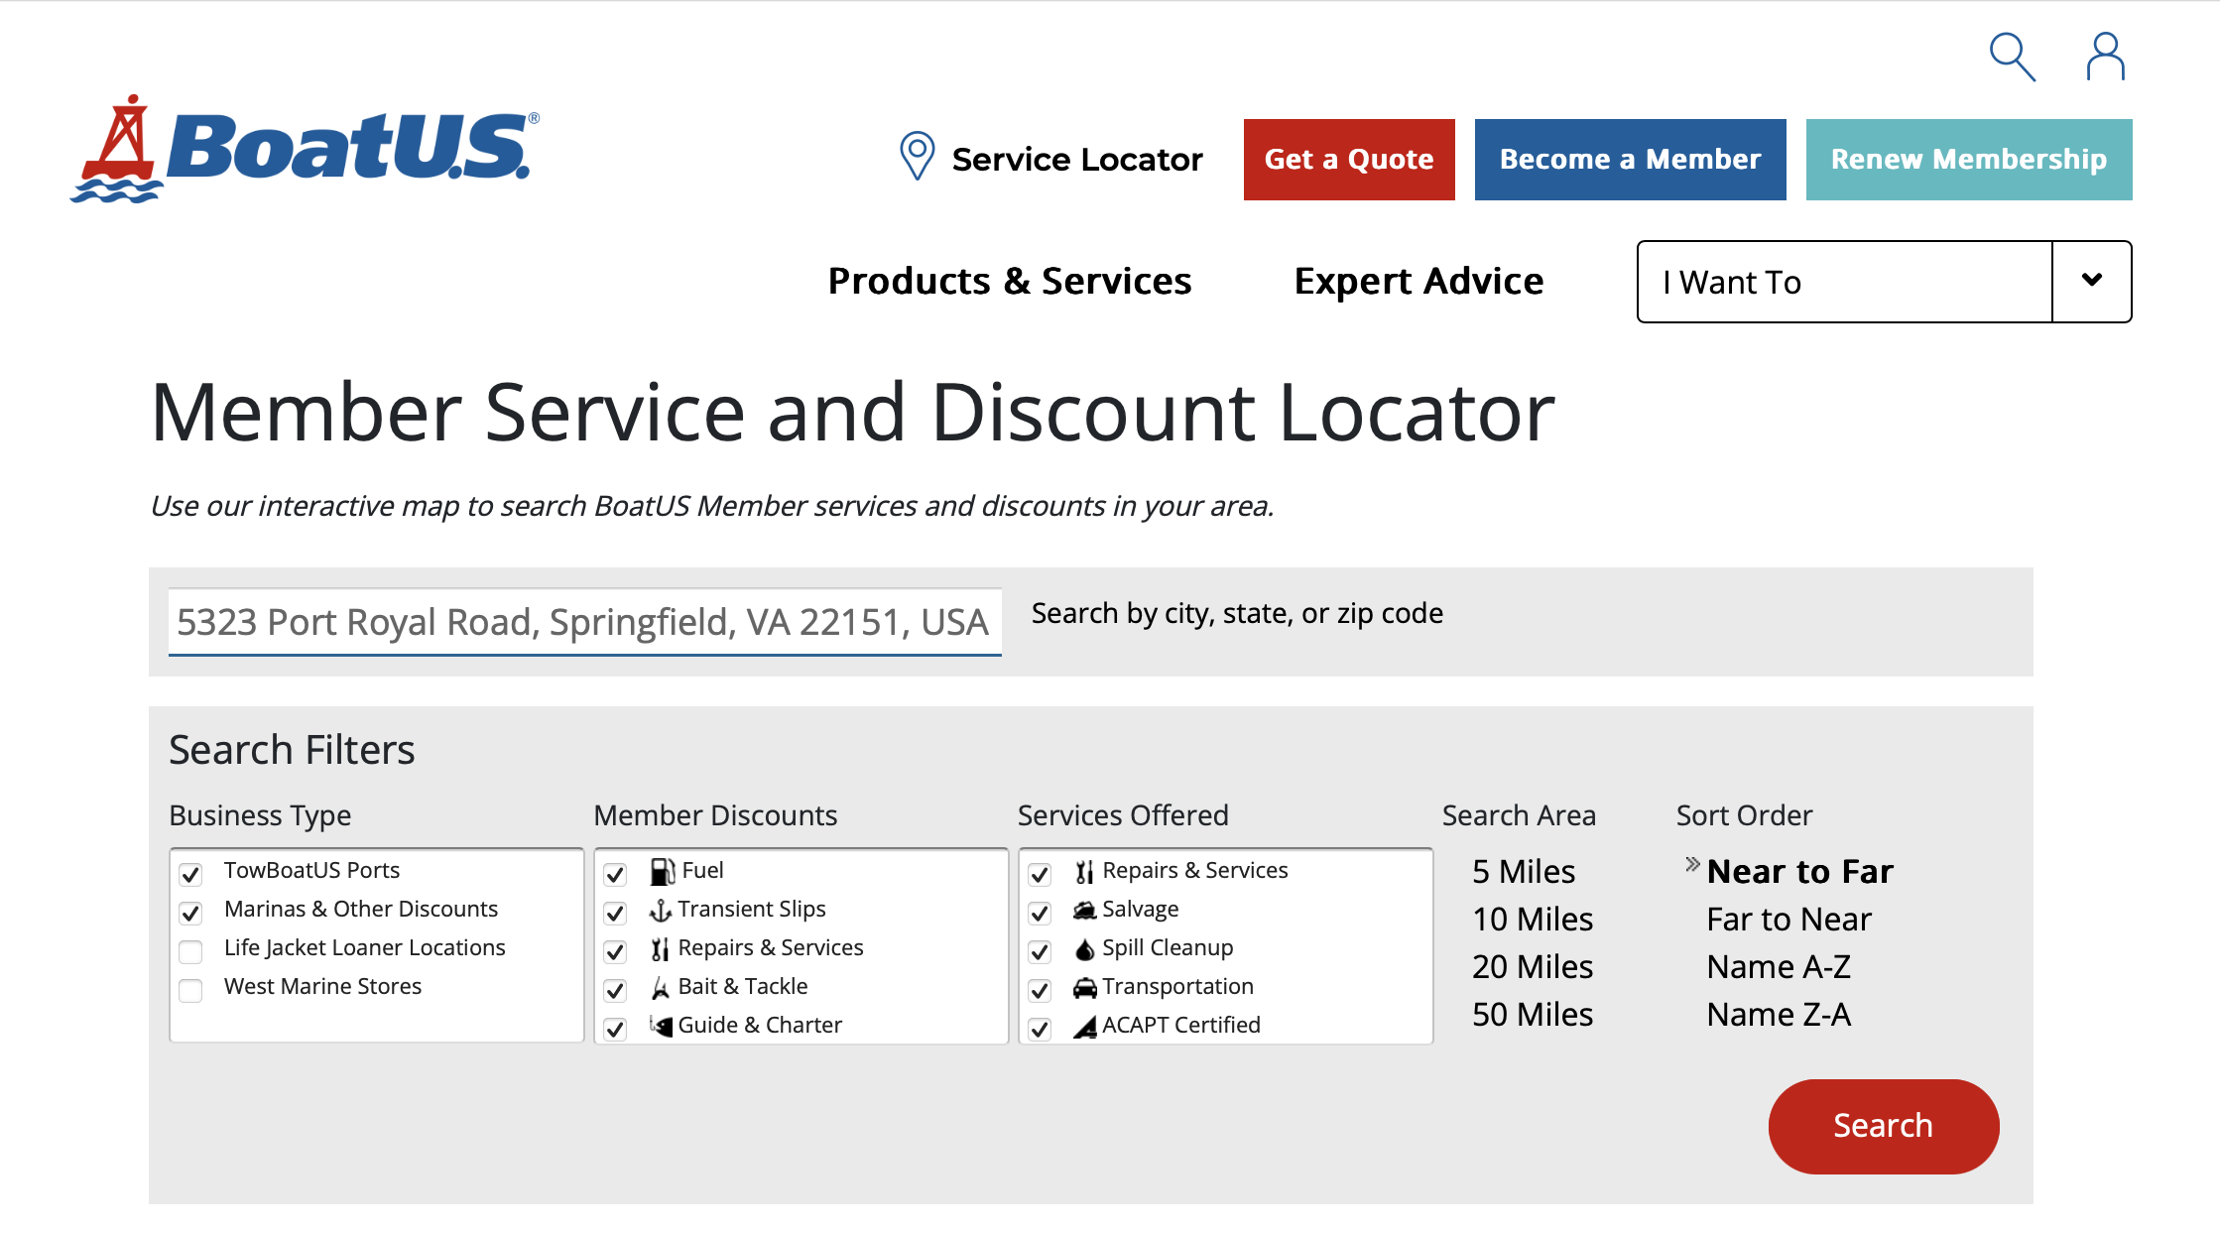
TO LEARN MORE
ABOUT US
Visit BoatUS.com
Download the free BoatU.S. mobile app
Visit BoatUS.com/Map
  Find the nearest BoatU.S. towing ports, Partner Network participants,
  Life Jacket Loaner Program locations and West Marine stores

